Slide 1
Season Setup – Starting a New Year
How to set up Pybricks and Git/github for new seasons

Slide 2
Initial Thoughts
This presentation assumes certain things are already installed, such as VS Code and Python, but will instead address updating them to the latest version
This presentation will address setting up a new git/github repository and getting it working in VS code
Ideally do this before summer so that any updates made to the base robot class are made for the upcoming season

Slide 3
Step 1. Update software
VS Code https://code.visualstudio.com/ Editing python programs. Use the "System Installer".
Python 3 https://www.python.org/ It's python. Install in c:\python\ (use the "custom installation" option)
git for Windows https://git-scm.com/downloads Be sure to select VS code as your default editor.
pybricks https://pybricks.com/ https://code.pybricks.com/ and https://beta.pybricks.com/ Nothing to install on your computer, but you will need to install it on your robot.

Slide 4
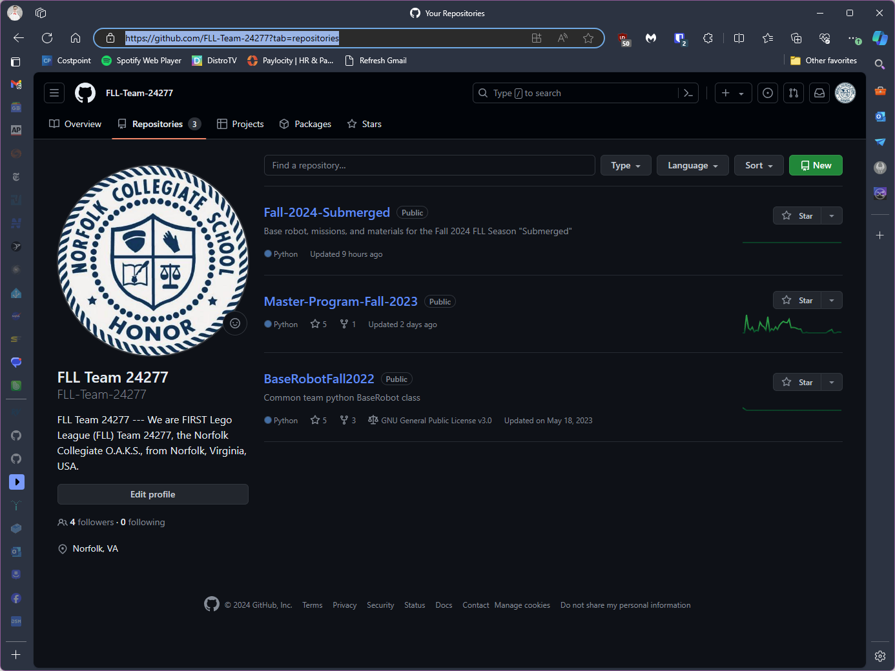
Step 2. Create github repo for new season
https://github.com/FLL-Team-24277?tab=repositories

Slide 5
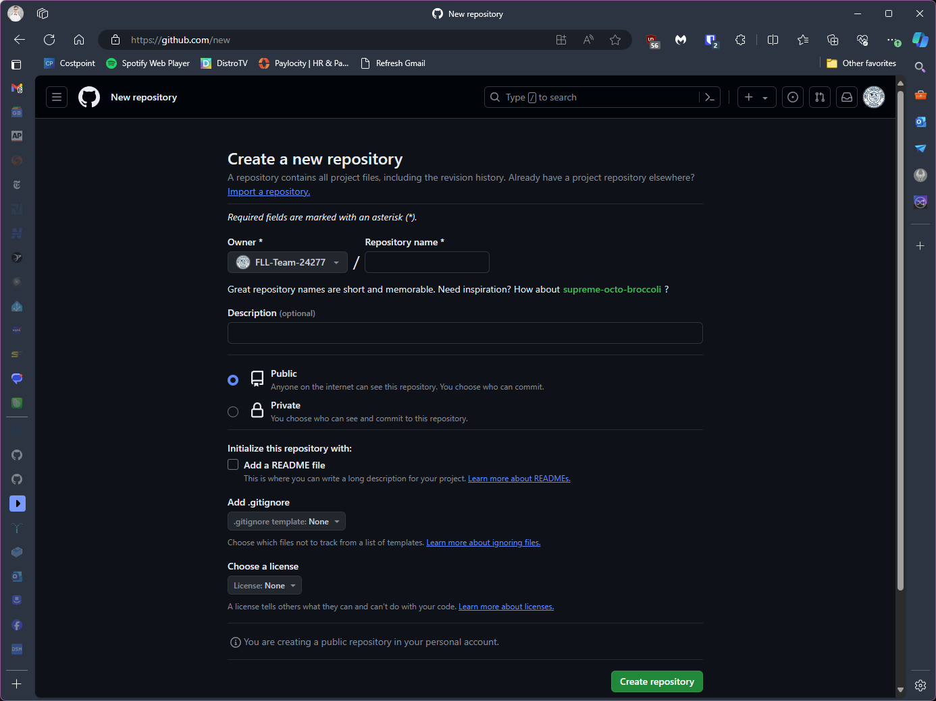
There are files from the previous season that are needed, but not all
There is an option to import an existing repo, which would require deleting files not needed
Or go with a blank repo and copy over just the files that are needed
In either case, wait until after the repo is cloned onto a computer before trying to get all of the files in place. It is easier to move/ copy/ delete the files in windows than on github.

Slide 6
Step 3. Invite Coach as a Collaborator
One of the coaches will invite you to be a collaborator on the team repository
Tell the coach your username so they can invite you

Slide 7
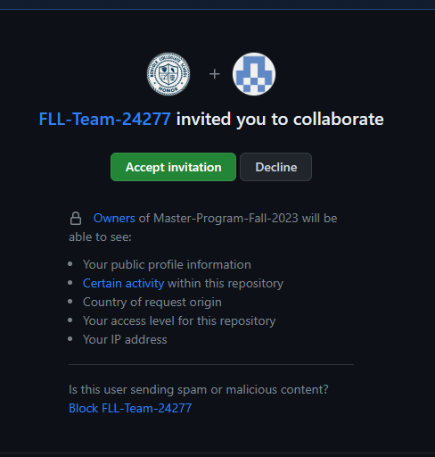
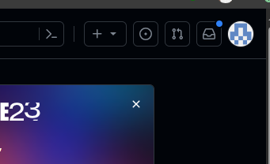
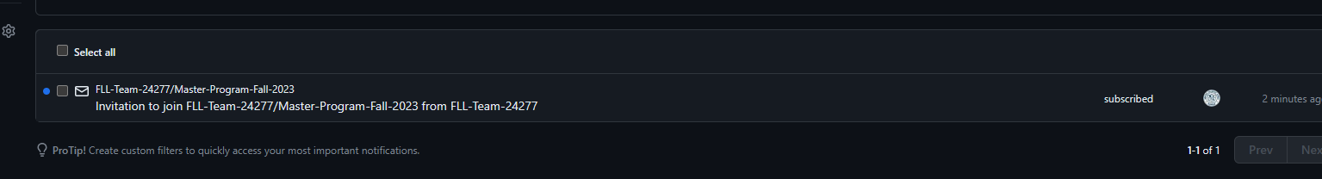

Slide 8
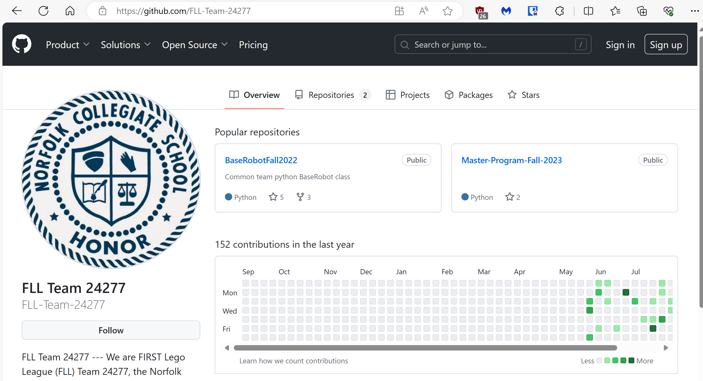
Step 4. Accept invitation
Look at your github notifications. Click “accept”
Go to the team github repo
Click on Master-Program-Fall-2023
https://github.com/FLL-Team-24277

Slide 9
Step 5. Clone the Repo in VS Code
Clone the Team’s Repository and open the project
Get the link from the Team github repository
Use the top-level folder where you want the repo. Cloning will automatically create the new folder for the season

Slide 10
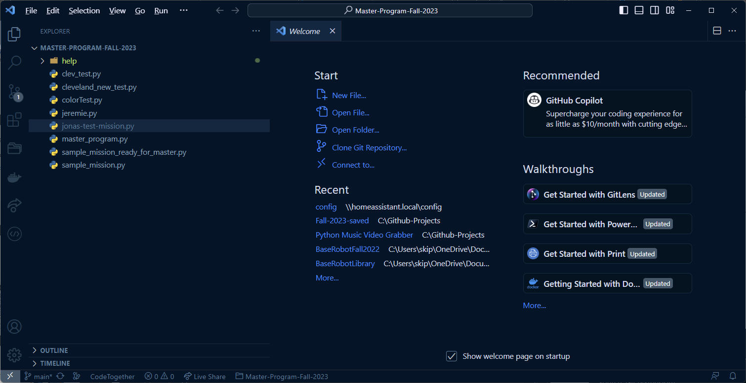
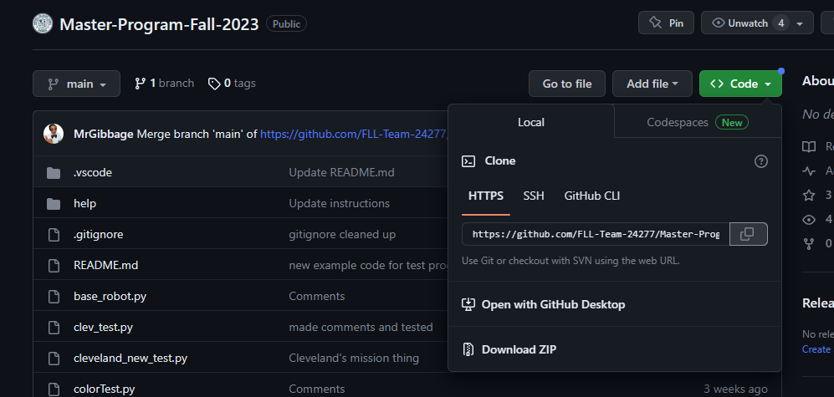

Slide 11
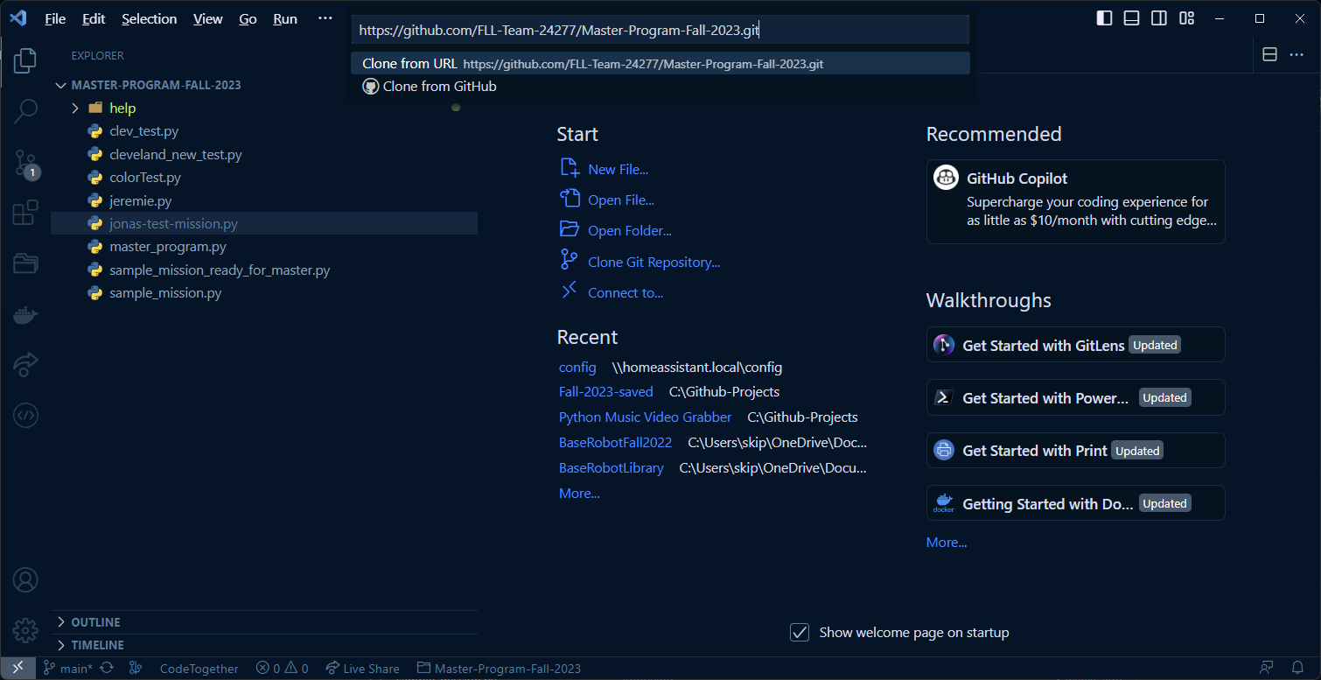

Slide 12
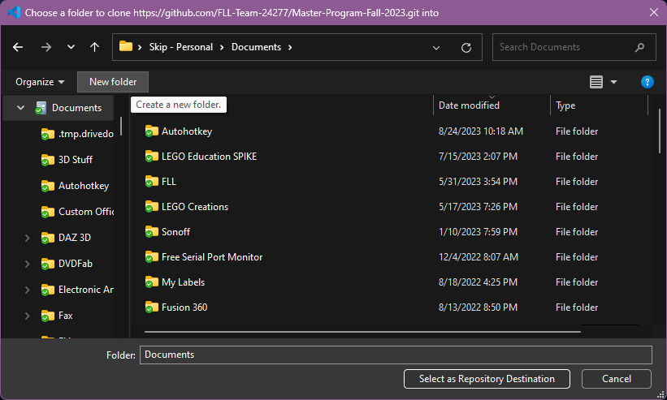
Create a new folder in your Documents and name it “FLL”.
Go into that folder and Select as Repository Destination

Slide 13
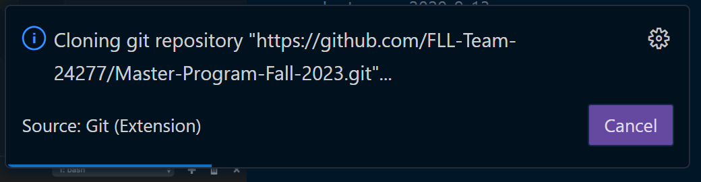
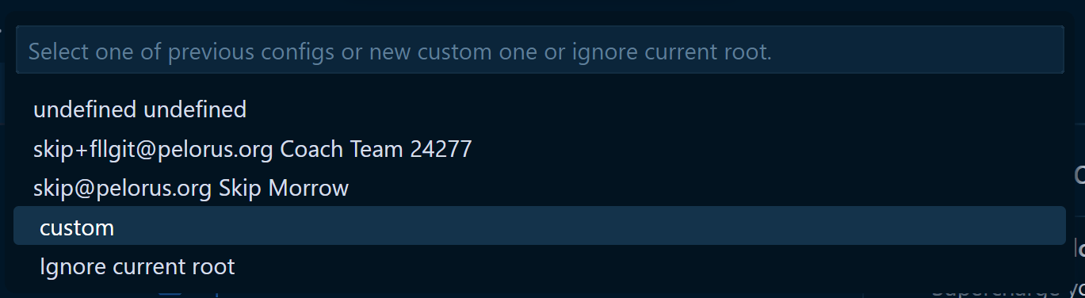

Slide 14
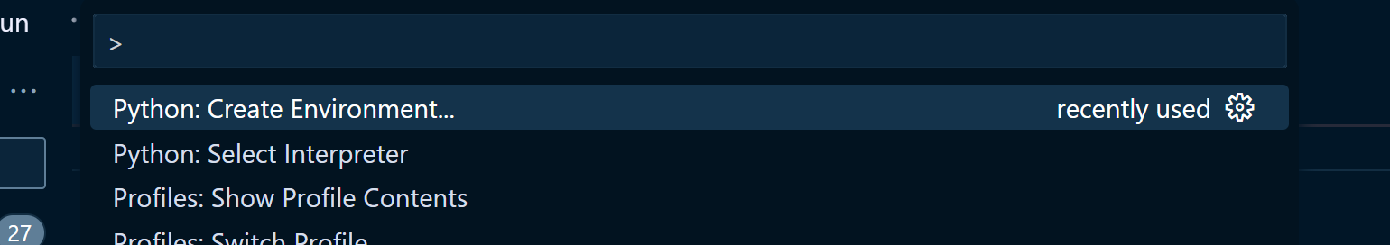
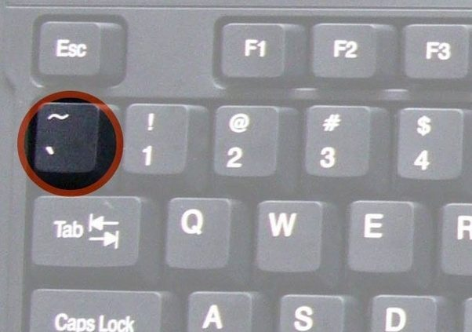
Step 6. Add Python Virtual Environment
Add a python virtual environment.
Ctrl-Shift-P > Python: Create Environment. Just use the defaults.
Pro-tip: Try typing Ctrl-Shift-P, then “cre env”
Open PowerShell
Set-ExecutionPolicy RemoteSigned
Pro-tip: Just type “set-ex” and then hit Tab, then type “re” and then hit Tab
Will need admin password
Restart VS Code
Open a new terminal with ctrl-shift-` or Ctrl-Shift-P > Create Terminal and make sure it is in the python virtual environment. It will start with a green "(.venv)".

Slide 15
Step 7. Python and Git Requirements
pip install -r .\requirements.txt
Pro-tip: type “pip install req” then hit Tab
If you entered your name and email address earlier, then you won’t need to do these next two steps
git config --global user.name “YourName“
Pro-tip: After running the user.name command, hit the cursor up-arrow, then edit the command to run the next command below
git config --global user.email “yourEmail@example.com"

Slide 16
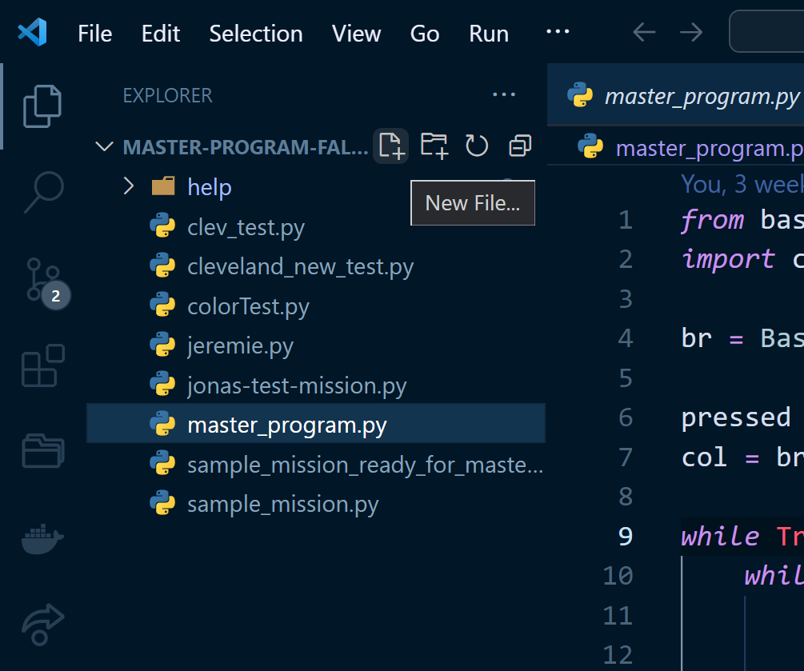
Step 8. Create Test File
Create a new python file, named teamMemberName-test-mission.py. Keep it all lowercase and no spaces. It MUST end with “.py”
Copy and paste the code from the team github page, and save it
Note that after saving the file, the python Black Formatter should correct the intentional "incorrect" spacing around the equals signs and commas.

Slide 17
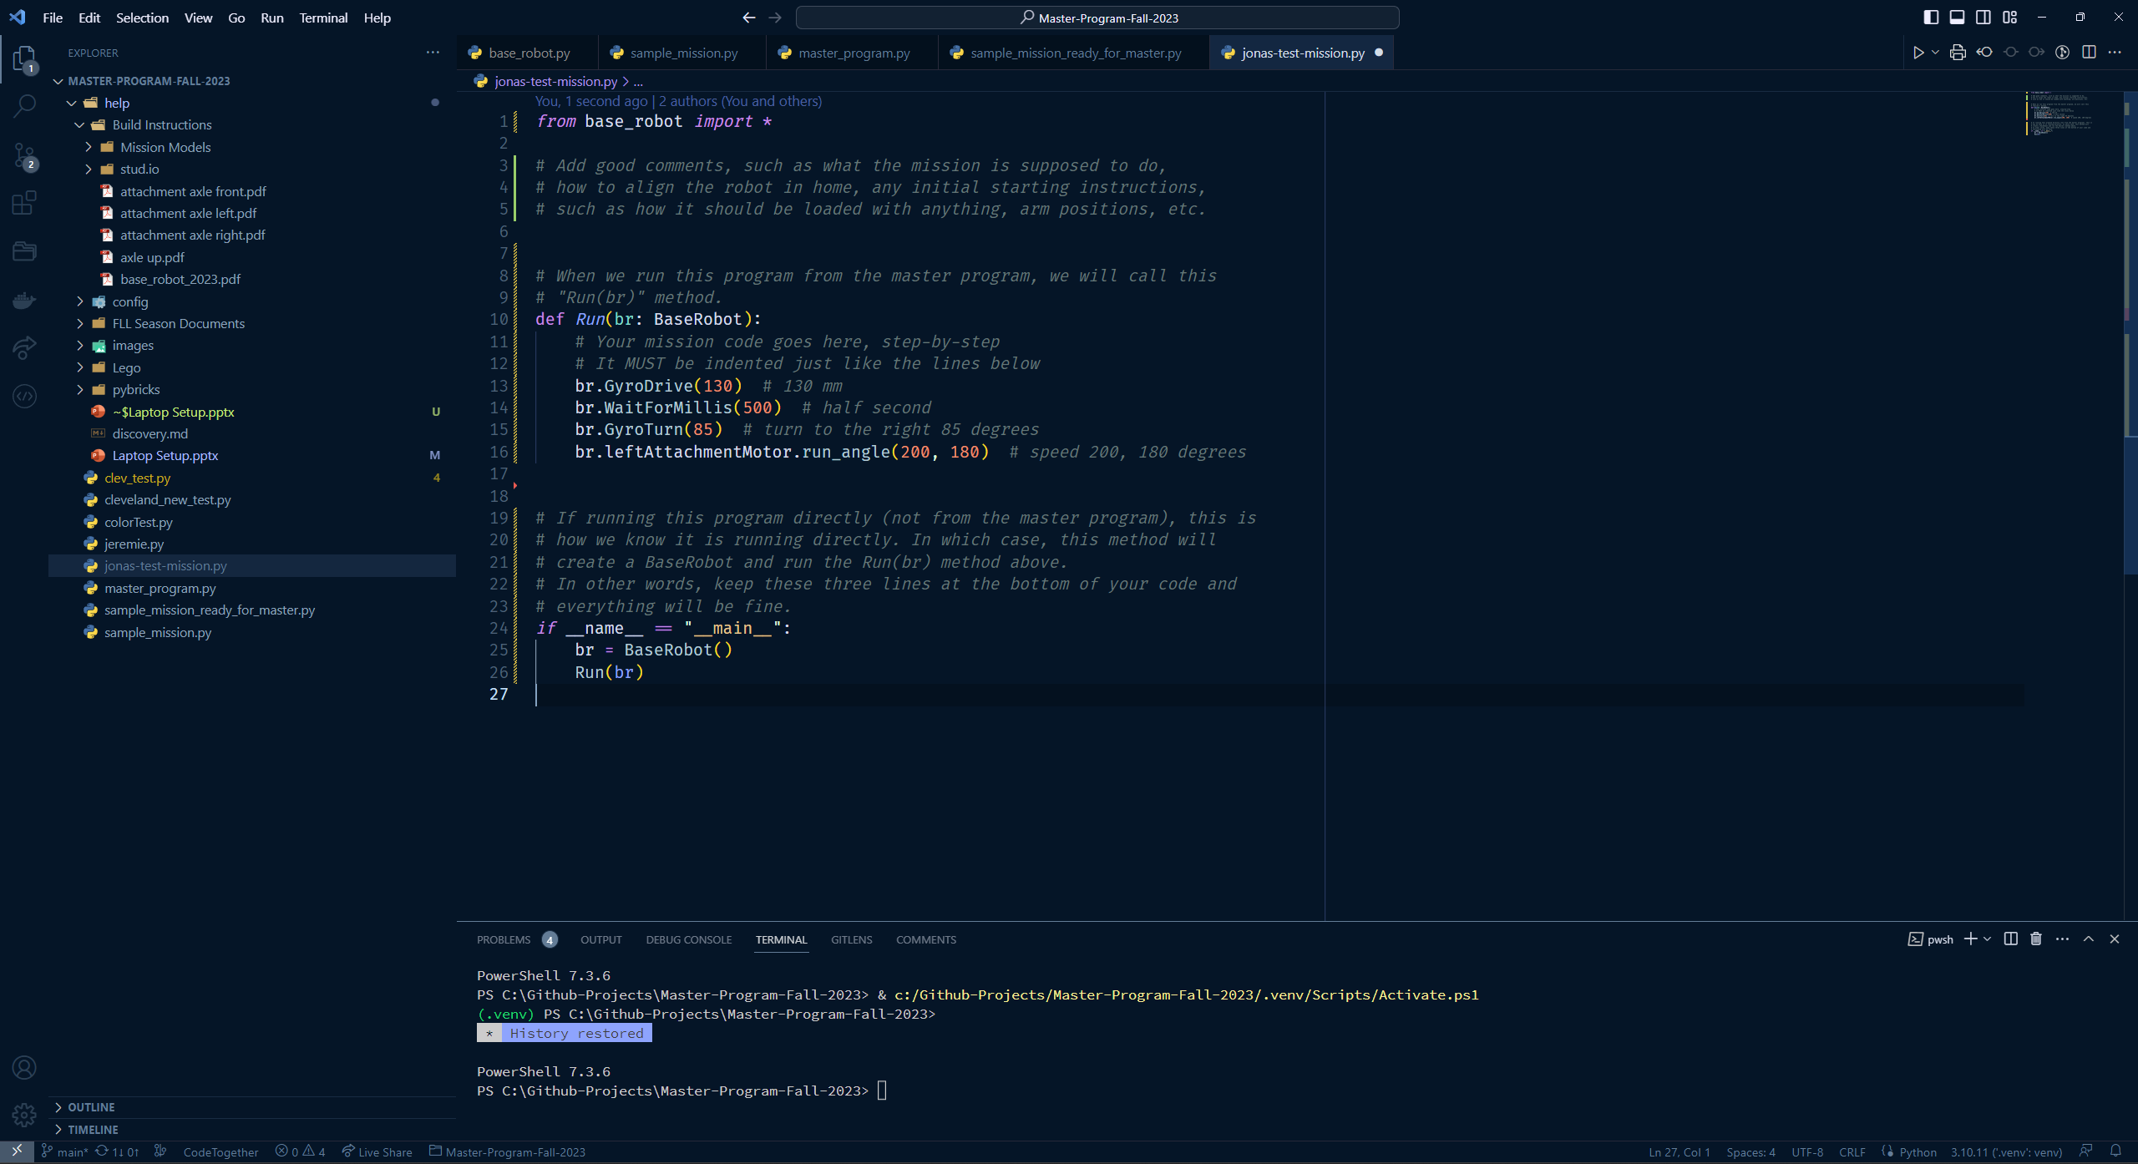

Slide 18
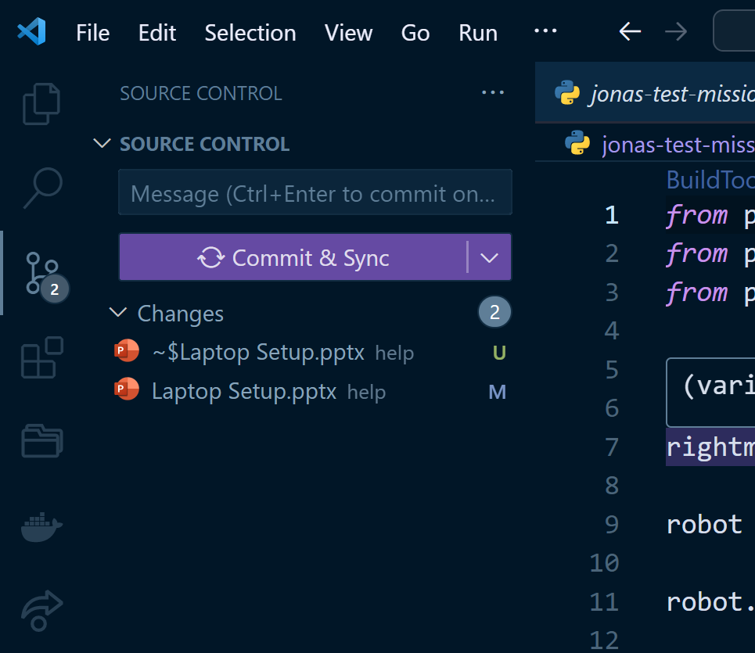
Step 9. Commit Changes
Press Ctrl-S to save your test program
Commit the changes, and push. It will probably prompt for github registration/login and then sync all files.
Just follow the prompts back to the github webpage that we left open
2
3
1

Slide 19
Step 10. Install Pybricks
Install pybricks on each robot at https://beta.pybricks.com/
If the computer has never connected to a pybricks hub, you will probably need to manually install the USB drivers
Name the robot at this time
Avoid spaces and special characters in the robot name
Put a label sticker on the top of the robot with the robot name.

Slide 20
Put hub in “Update Mode”
Preparation:
Disconnect the USB cable.
Make sure the hub is turned off.
Enter update mode (see video):
Press and hold the Bluetooth button on the hub.
Connect the USB cable.
Wait for the Bluetooth light to start blinking pink-green-blue-off.
Release the Bluetooth button.

Slide 21
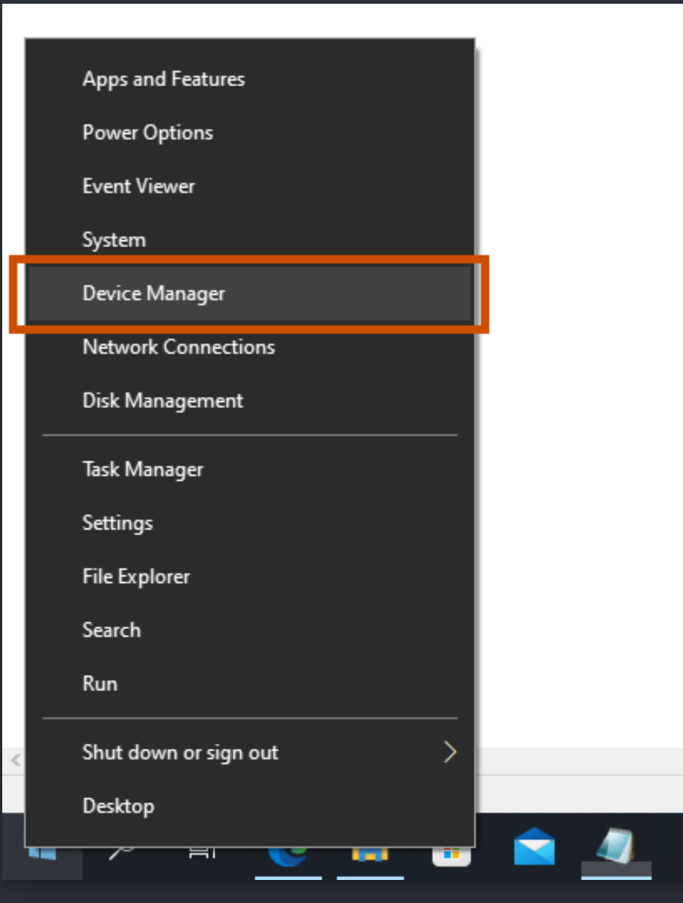
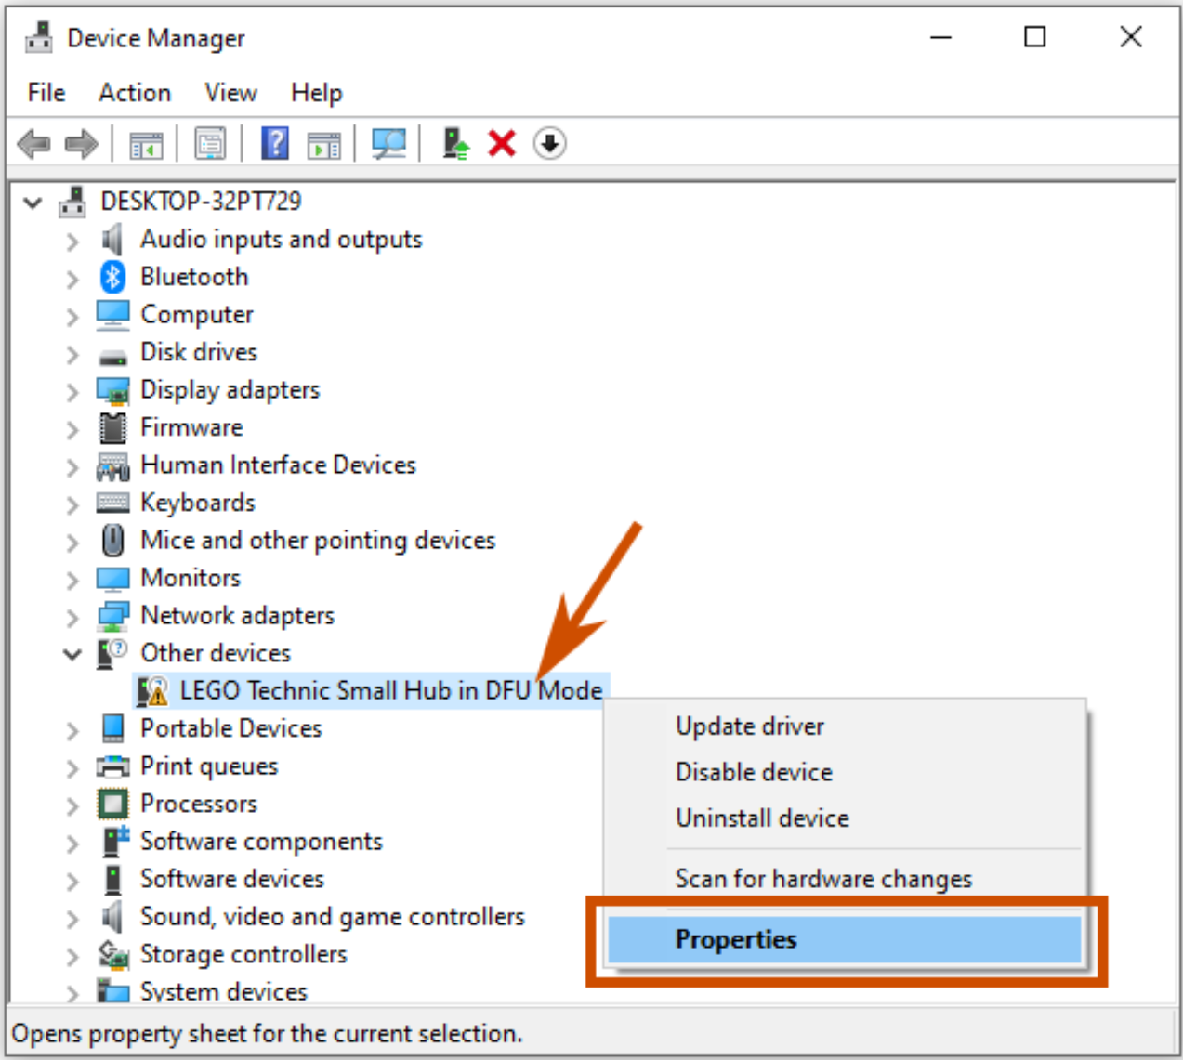
Click on the start menu, then type “dev”

Slide 22
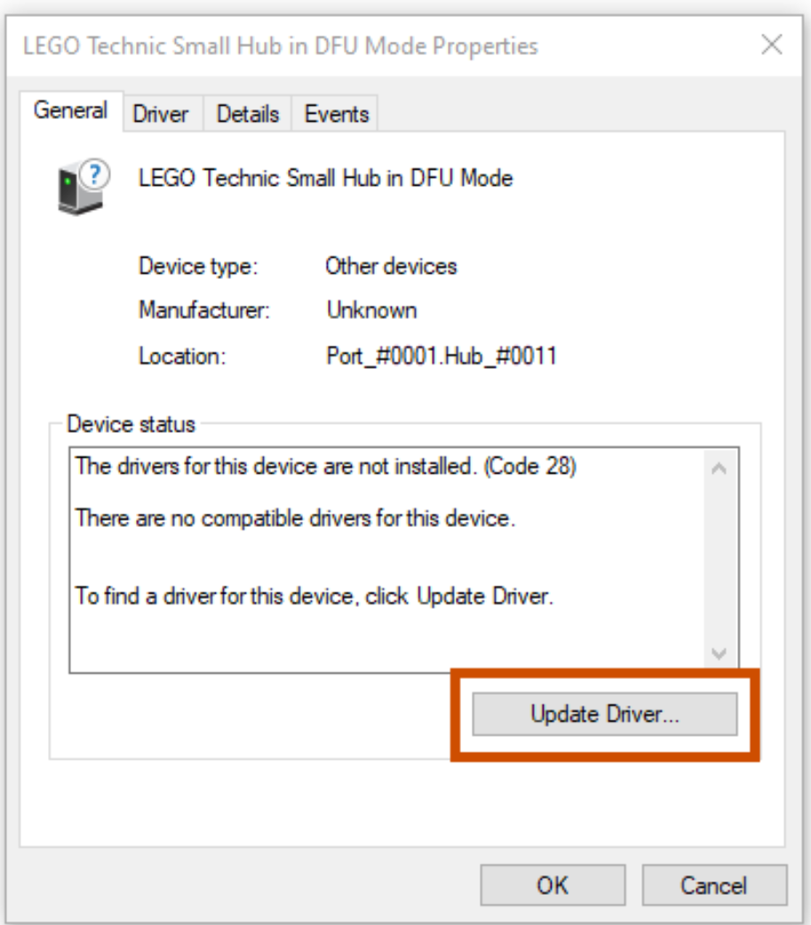
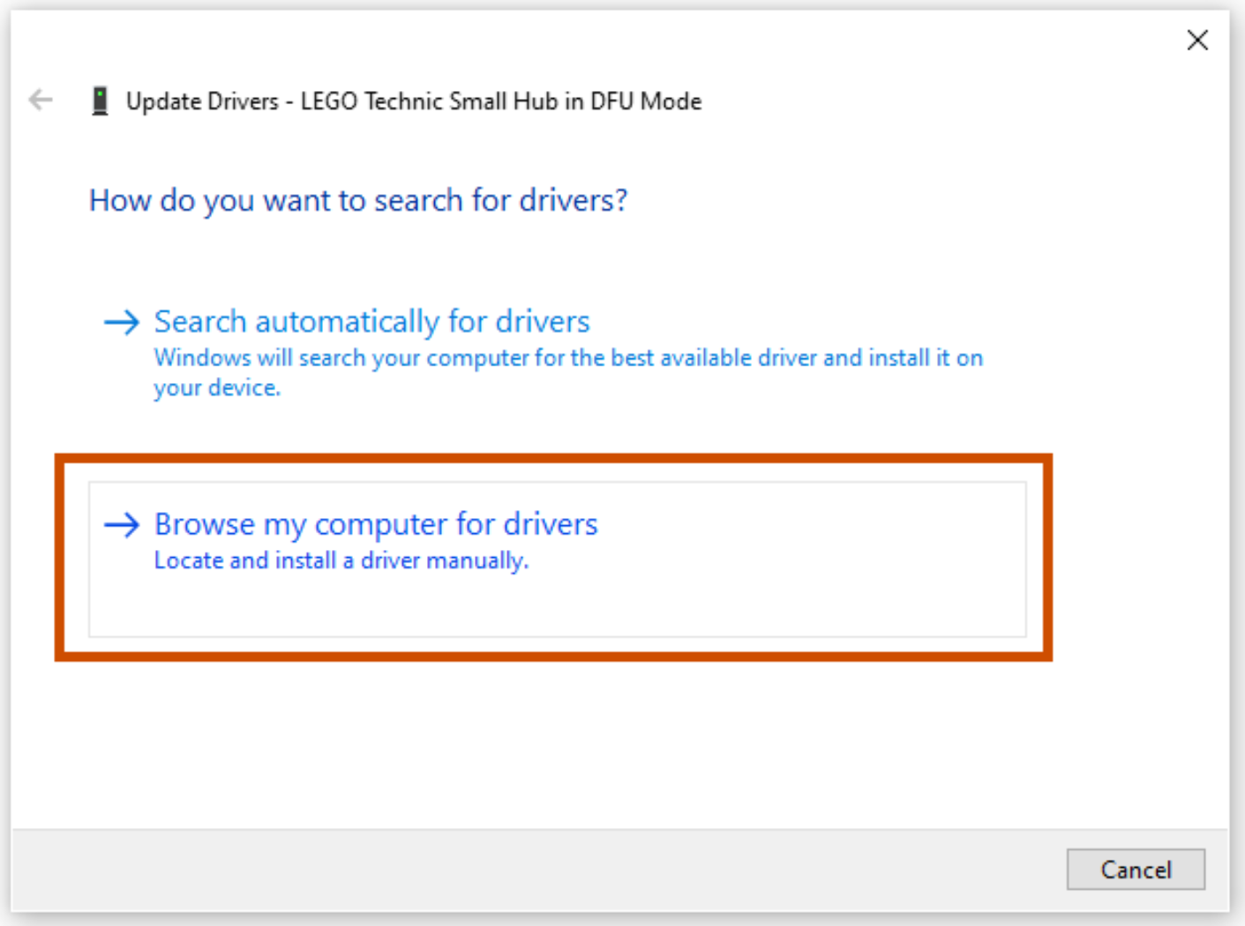
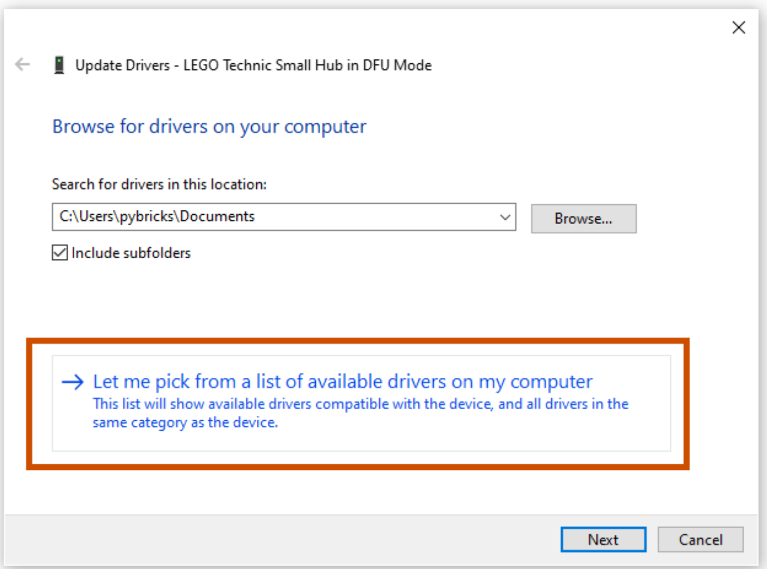
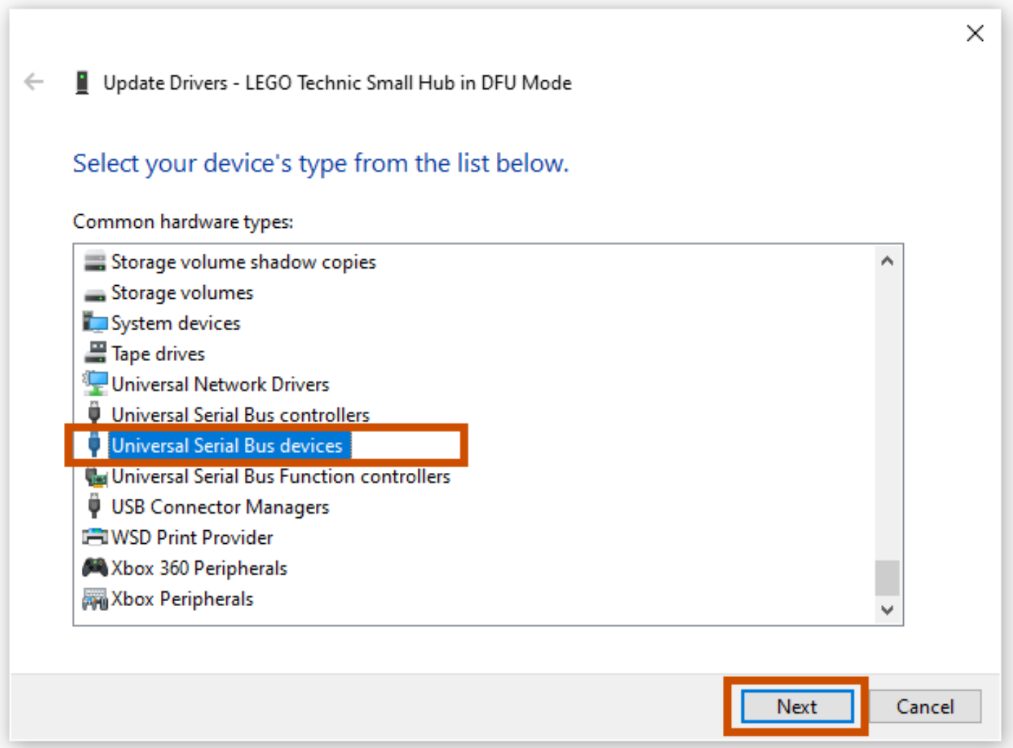
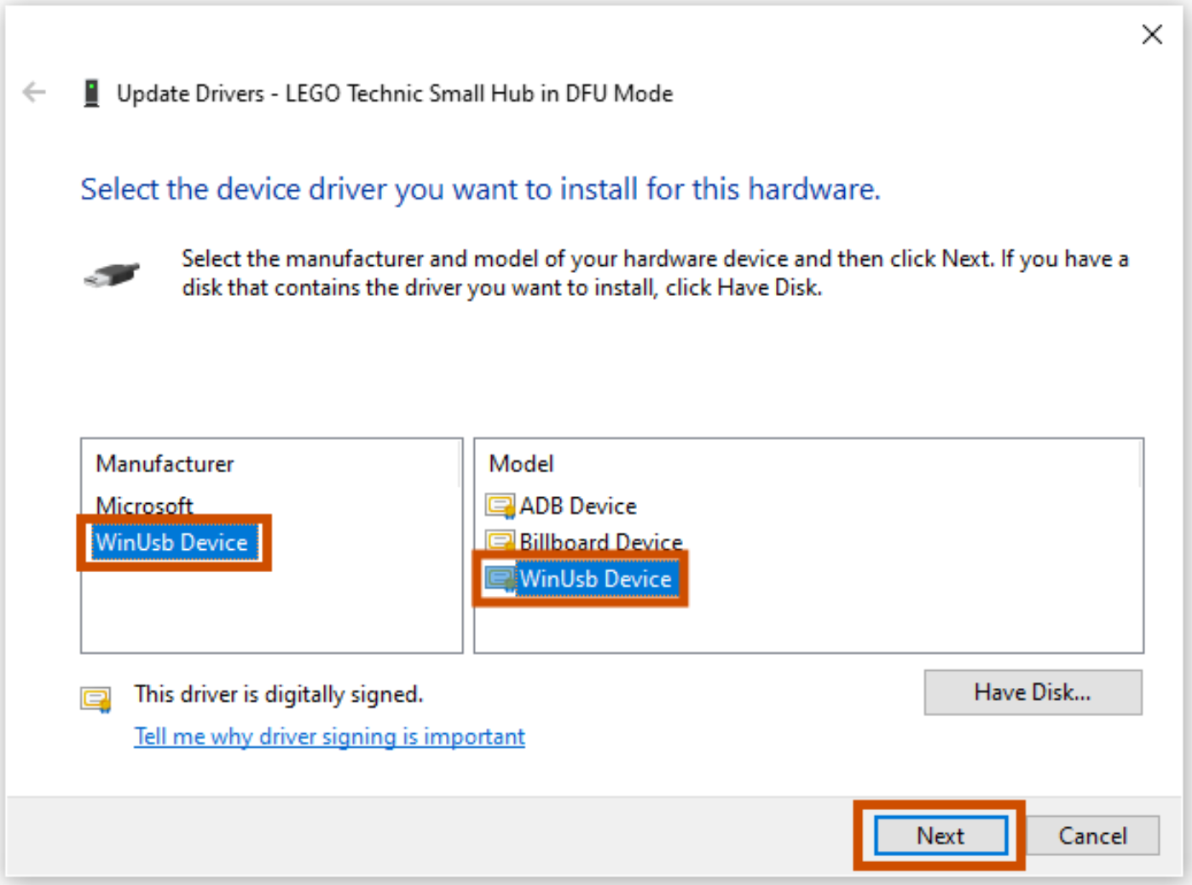

Slide 23
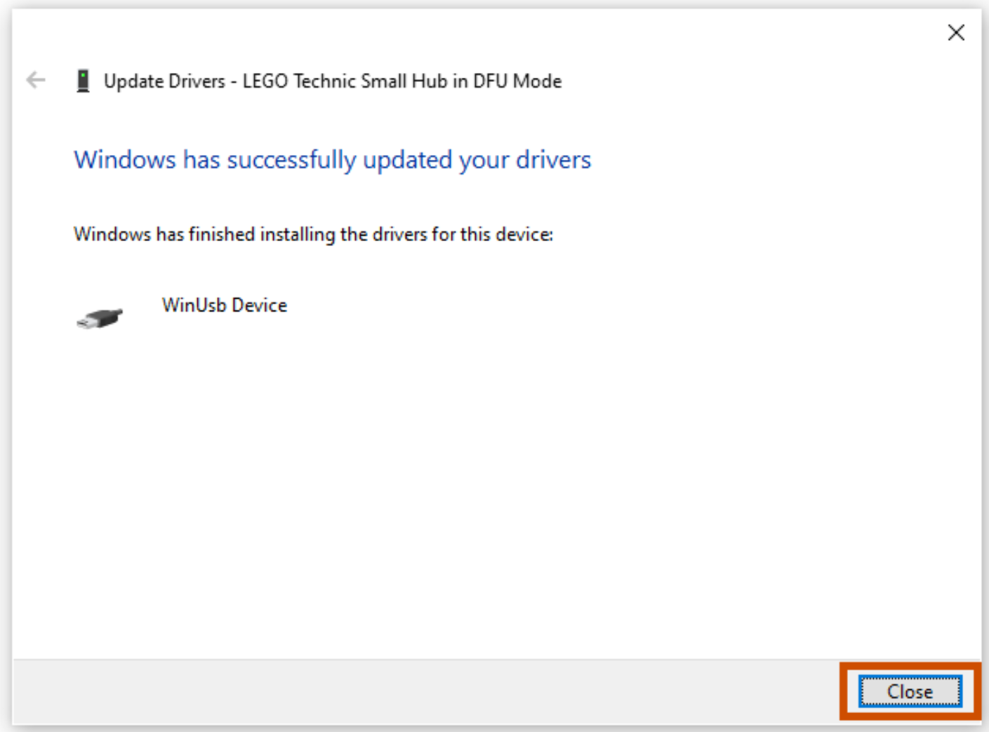
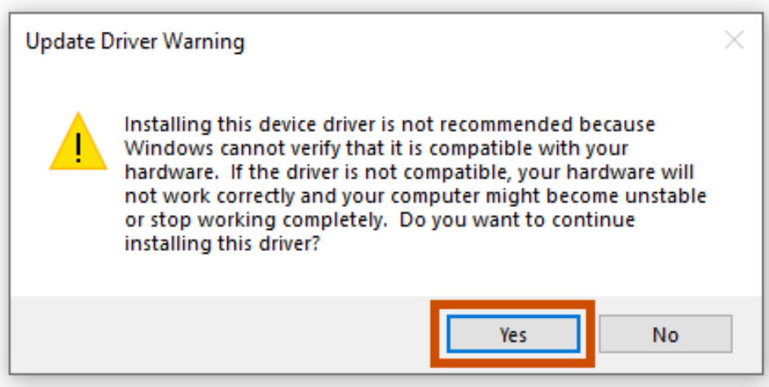

Slide 24
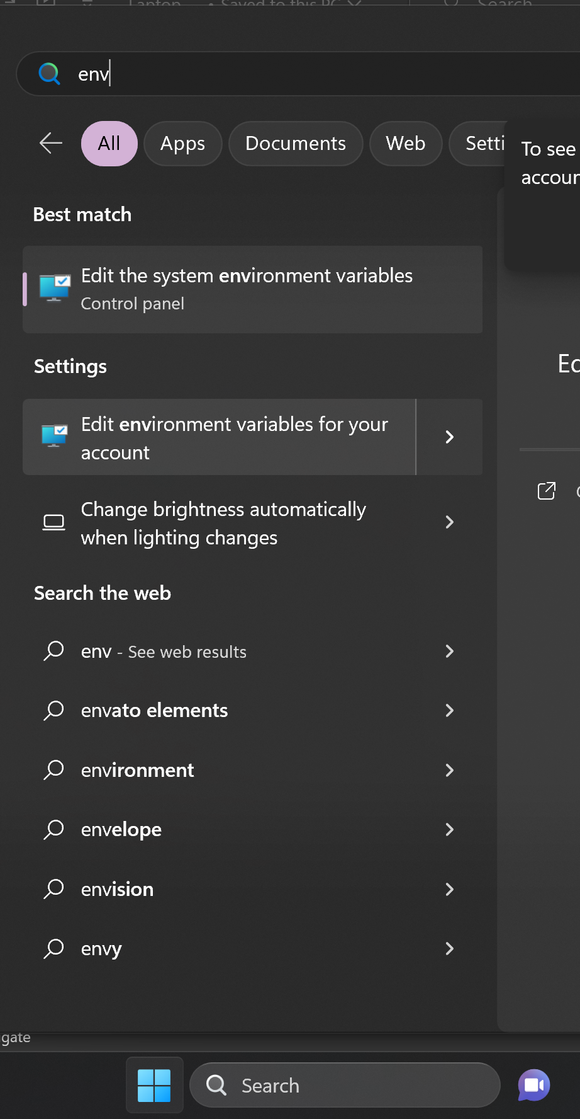
Step 11. User Environment Variables
2
Create a User environment variable for the robot name
Set the variable robotName to the name of the robot
This should allow the keyboard binding and tasks to recognize the robot by name
Restart VS Code and open a new terminal and then test it with echo $env:robotName
1: Click on Start Menu
2: Type “env”
3: Click on “Edit Environment Variables for your account”
3
1

Slide 25
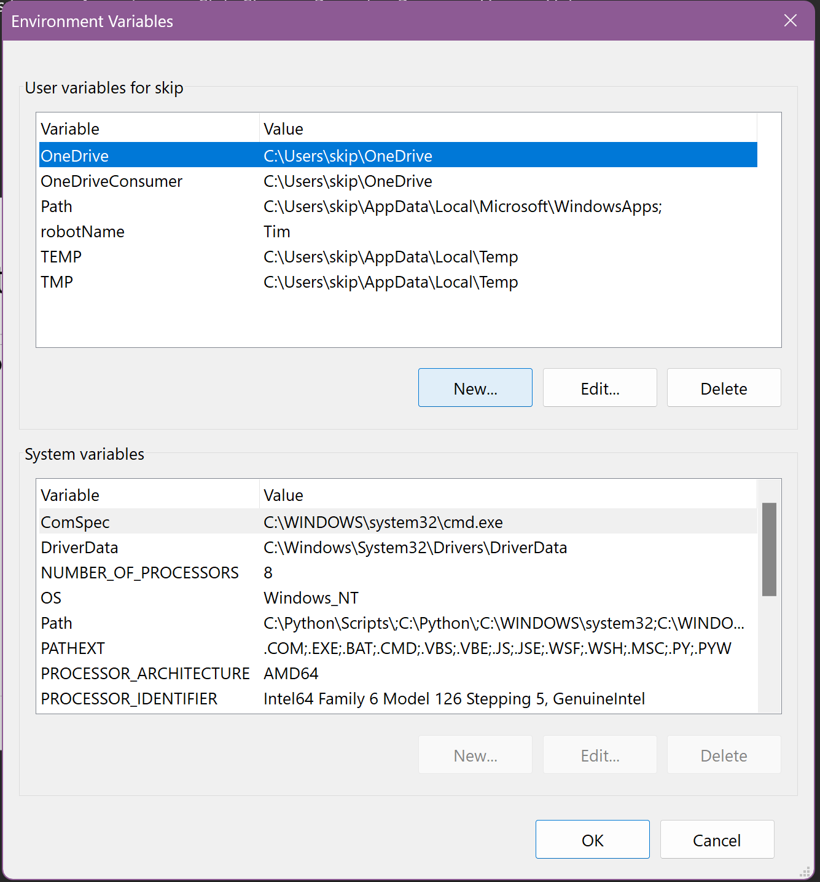
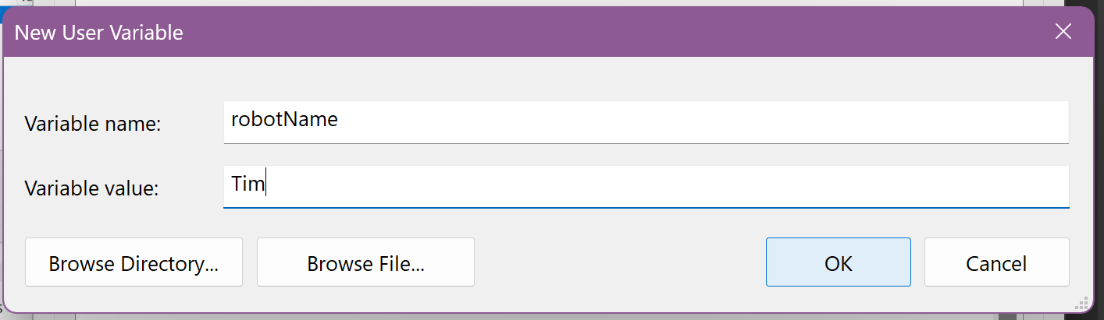
Enter “robotName”
Enter YOUR robot’s name

Slide 26
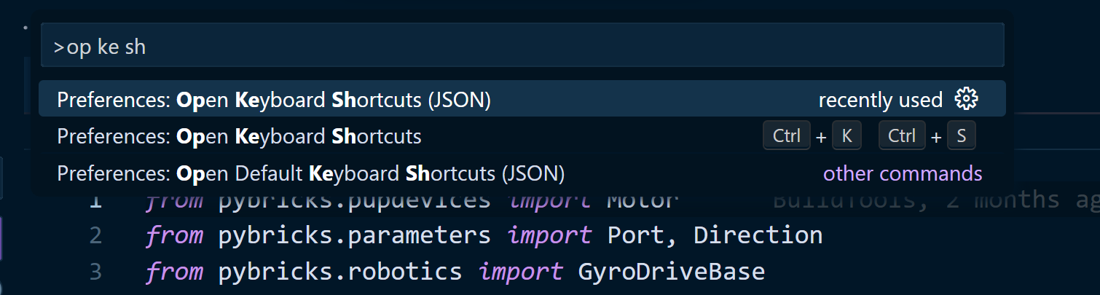
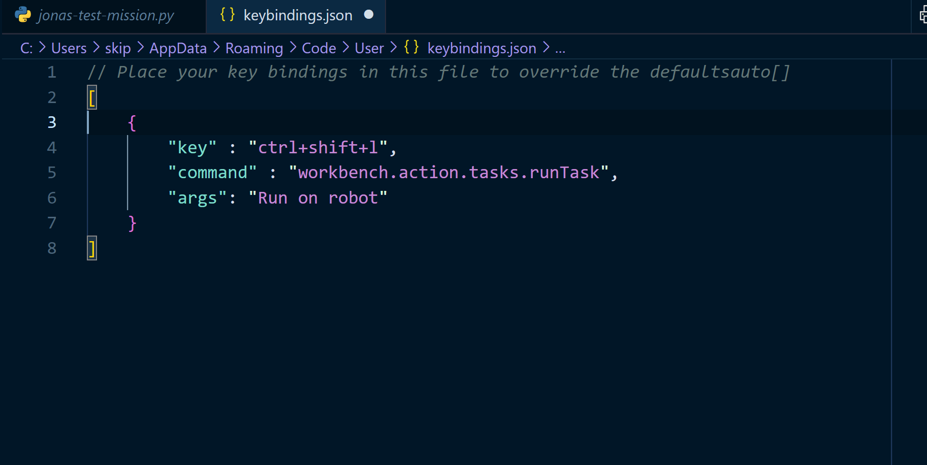
Step 12. Keyboard Shortcut
Last step, I promise! Add a keyboard shortcut to run the programs that we write. Ctrl-Shift-P > Preferences: Open Keyboard Shortcuts (JSON).
Pro-tip: type Ctrl-Shift-P, then type “op ke sh”.
Make sure you choose the entry that says “JSON” at the end
Edit the JSON to add the keyboard shortcut to run the task. Paste in the code from the team repo at the bottom of keybindings.json.

Slide 27
Step 13.
RUN OUR PROGRAM!
Turn the robot on and ensure the keyboard shortcut ctrl-shift-L runs the command, which should also run their program
Also, Ctrl-Shift-P > Tasks: Run task should pop up a menu with the correct entry
Watch the terminal and make sure the robot name is correct. If not, recheck that you completed step 11 correctly.

